Slide 1
Relations and Functions
MGSE8.F.1 Understand that a function is a rule that assigns to each input exactly one output. The graph of a function is the set of ordered pairs consisting of an input and the corresponding output.
MGSE8.F.2 Compare properties of two functions each represented in a different way (algebraically, graphically, numerically in tables, or by verbal descriptions). For example, given a linear function represented by a table of values and a linear function represented by an algebraic expression, determine which function has the greater rate of change.

Slide 2
Essential Questions:
What is a function?
What are the characteristics of a function?
How do you determine if a relation is a function?
How is a function different from a relation?
Why is it important to know which variable is the independent variable?

Slide 3
Some Definitions-
A relation between two variables x and y is a set of ordered pairs
An ordered pair consists of an x and y-coordinate
  A relation may be viewed as ordered pairs, mapping design, table, equation, or written in sentences
x-values are input, independent variable, domain.
y-values are output, dependent variable, range

Slide 4

Example 1:
What makes this a relation?
What is the domain?
{0, 1, 2, 3, 4, 5}
What is the range?
{-5, -4, -3, -2, -1, 0}

Slide 5
Example 2 –
Is this a relation?
4
–5
0
9
–1
Input
–2
7
Output
What is the domain?
{4, -5, 0, 9, -1}
What is the range?
{-2, 7}

Slide 6
Is a relation a function?
What is a function?
According to a textbook, “a function is…a relation in which every input has exactly one output”

Slide 7
Is a relation a function?
Focus on the x-coordinates, when given a relation
If the set of ordered pairs has different x-coordinates,
it IS A function
If the set of ordered pairs has same x-coordinates,
it is NOT a function
Y-coordinates have no bearing in determining functions

Slide 8
Example 3
:00
Is this a relation?
Is this a function?
  Hint: Look only at the x-coordinates
YES
YES

Slide 9
Example 4
:40
Is this a function?
  Hint: Look only at the x-coordinates
NO
Is this still a relation?
YES

Slide 10
Example 5
:40
Which relation mapping represents a function?
Choice One Choice Two
–1
2
3
2
–1
3
2
3
–2
0
3
1
0
Choice 1

Slide 11
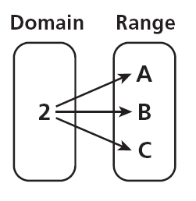
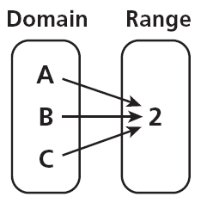
Example 6
Which relation mapping represents a function?
A. B.
B

Slide 12
Vertical Line Test
Vertical Line Test: a relation is a function if a vertical line drawn through its graph, passes through only one point.
AKA: “The Pencil Test”
Take a pencil and move it from left to right (–x to x); if it crosses more than one point, it is not a function

Slide 13
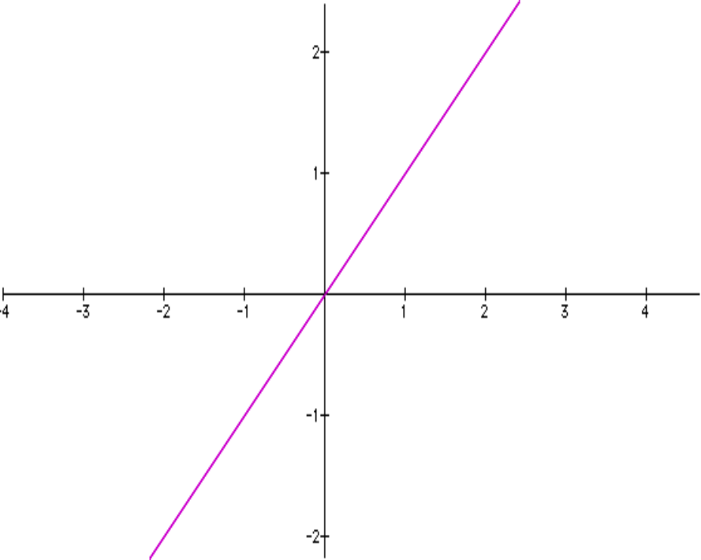
Vertical Line Test
Would this graph be a function?
YES

Slide 14
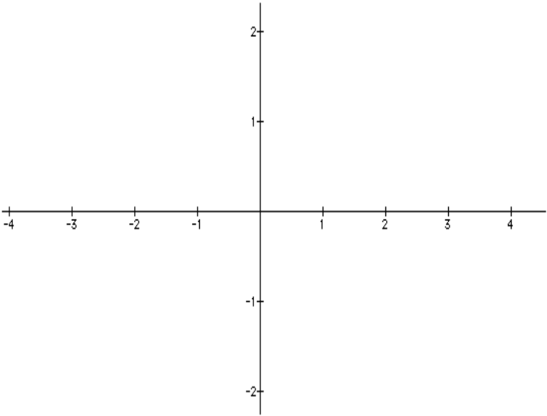
Vertical Line Test
Would this graph be a function?
NO

Slide 15
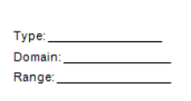
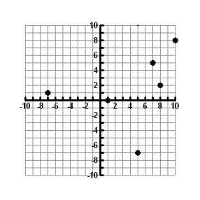


Is the following function discrete or continuous? What is the Domain? What is the Range?
Discrete

Slide 16
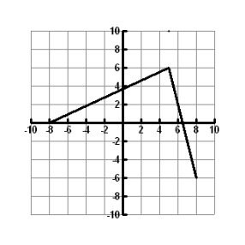
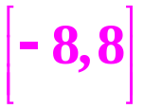
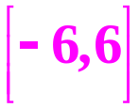
Is the following function discrete or continuous?
What is the Domain? What is the Range?
continuous

Slide 17
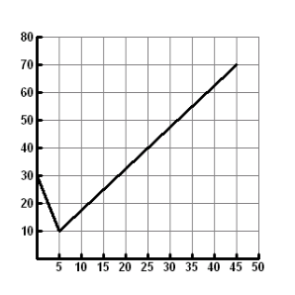
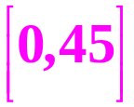
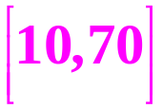
Is the following function discrete or continuous? What is the Domain? What is the Range?
continuous

Slide 18
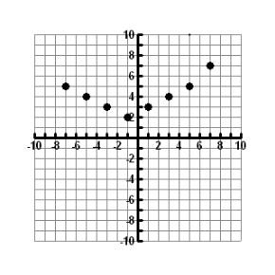


Is the following function discrete or continuous? What is the Domain? What is the Range?
discrete

Slide 19
Example 7
Which situation represents a function?
a. The items in a store to their prices on a certain date
b. Types of fruits to their colors
There is only one price for each different item on a certain date. The relation from items to price makes it a function.
A fruit, such as an apple, from the domain would be associated with more than one color, such as red and green. The relation from types of fruits to their colors is not a function.

Slide 20
Domain and Range in Real Life
The number of shoes in x pairs of shoes can be expressed by the equation y = 2x.
What is the independent variable?
The # of pairs of shoes.
What is the dependent variable?
The total # of shoes.

Slide 21
Domain and Range in Real Life
Johnny bought at most 10 tickets to a concert for him and his friends. The cost of each ticket was $12.50.
Complete the table below to list the possible domain and range.
7
1 | 2 | 3
12.50 | 25.00 | 37.50
4
5
6
8
9
10
50
62.50
75
87.50
100
112.50
125
What is the independent variable?
The number of tickets bought.
What is the dependent variable?
The total cost of the tickets.

Slide 22
Domain and Range in Real Life
Pete’s Pizza Parlor charges $5 for a large pizza with no toppings. They charge an additional $1.50 for each of their 5 specialty toppings (tax is included in the price).
What is the independent variable?
The number of toppings
What is the dependent variable?
The cost of the pizza

